Slide 1
Logical Operators

Slide 2
LIKE condition
LIKE condition is used to perform pattern matching to find the correct result.
It is used in SELECT, INSERT, UPDATE and DELETE statement with the combination of WHERE clause.
Syntax:
expression LIKE pattern [ ESCAPE 'escape_character' ]
Parameters
expression: It specifies a column or field.
pattern: It is a character expression that contains pattern matching.
escape_character: It is optional. It allows you to test for literal instances of a wildcard character such as % or _. If you do not provide the escape_character, MySQL assumes that "\" is the escape_character.

Slide 3
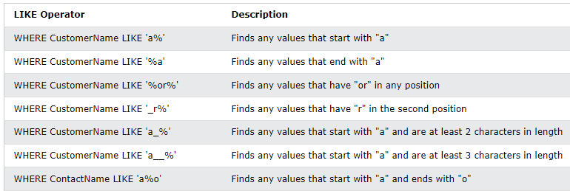
Different LIKE operators with '%' and '_' wildcards:

Slide 4
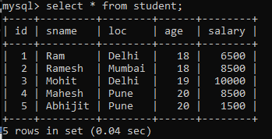
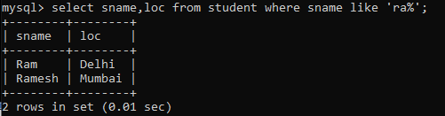
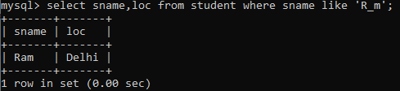
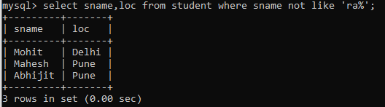
Examples
1) Using % (percent) Wildcard:
2) Using _ (Underscore) Wildcard:
3) using not like:

Slide 5
AND, OR and NOT Operators
The WHERE clause can be combined with AND, OR, and NOT operators.
The AND and OR operators are used to filter records based on more than one condition:
The AND operator displays a record if all the conditions separated by AND are TRUE.
The OR operator displays a record if any of the conditions separated by OR is TRUE.
The NOT operator displays a record if the condition(s) is NOT TRUE.

Slide 6
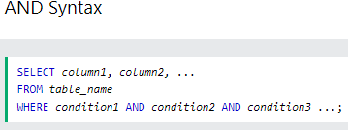
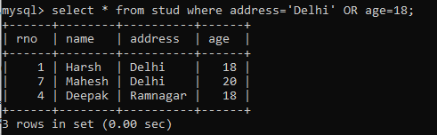
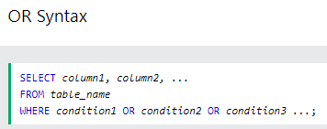
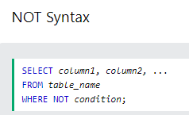

Slide 7
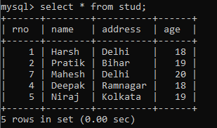
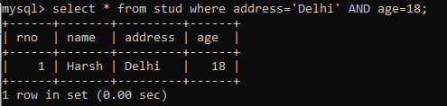
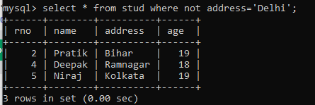

Slide 8
IN Condition
The IN operator allows you to specify multiple values in a WHERE clause.
The IN operator is a shorthand for multiple OR conditions.
Syntax
SELECT column_name(s) FROM table_name WHERE column_name IN (value1, value2, ...);
OR
SELECT column_name(s) FROM table_name WHERE column_name IN (SELECT STATEMENT);

Slide 9
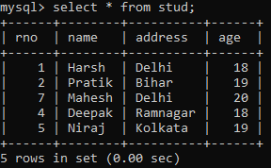
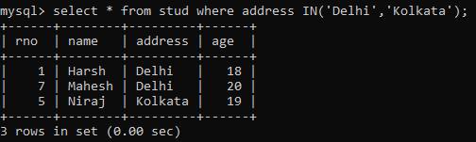
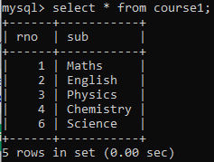
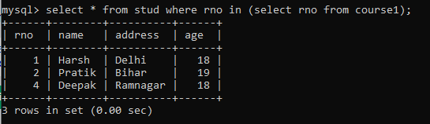
Examples

Slide 10
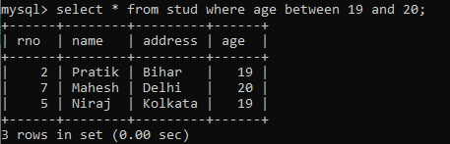
BETWEEN Operator
The BETWEEN operator selects values within a given range. The values can be numbers, text, or dates.
The BETWEEN operator is inclusive: begin and end values are included.
Syntax
SELECT column_name(s) FROM table_name WHERE column_name BETWEEN value1 AND value2;

Slide 11
ANY Operator
The ANY operator is used to verify if any single record of a query satisfies the required condition.
This operator returns a TRUE, if the given condition is satisfied for any of the values in the range.
If none of the values in the specified range satisfy the given condition, this operator returns false.
You can also use another query (subquery) along with this operator.

Slide 12
Syntax
Column_name operator ANY (subquery);
column_name is the name of a column in the main query.
operator is a comparison operator such as =, <, >, <=, >=, or <>.
subquery is a SELECT statement that returns a single column of values.

Slide 13
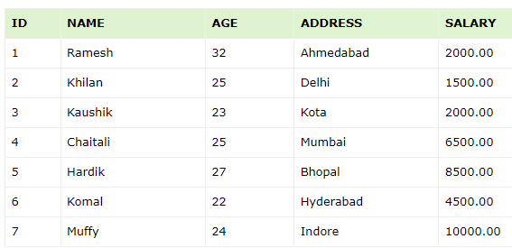
Example:
Consider the CUSTOMERS table which contains the personal details of customers including their name, age, address and salary etc.

Slide 14
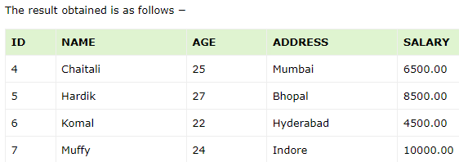
list out the details of all the CUSTOMERS whose SALARY is greater than the SALARY of any customer whose AGE is 32.
SELECT * FROM CUSTOMERS WHERE SALARY > ANY (SELECT SALARY FROM CUSTOMERS WHERE AGE = 32);

Slide 15
ALL Operator
The SQL ALL operator returns all the records of the SELECT statement.
It returns TRUE if the given condition is satisfied for ALL the values in the range.
It always returns a Boolean value.
It is used with SELECT, WHERE and HAVING statements in SQL queries.
The data type of the values returned from a subquery must be the same as the outer query expression data type.

Slide 16
Syntax:
Column_name operator ALL (subquery);
Example
The details of all the customers whose salary is not equal to the salary of any customer whose age is 25
SELECT * FROM CUSTOMERS WHERE SALARY <> ALL (SELECT SALARY FROM CUSTOMERS WHERE AGE = 25);

Slide 17
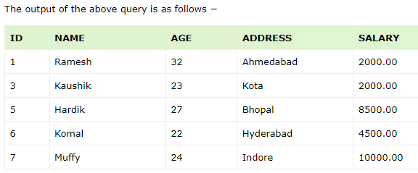
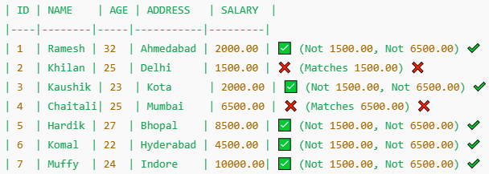

Slide 18
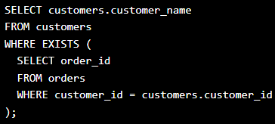
EXISTS
The EXISTS operator is used to test for the existence of any record in a sub query.
The EXISTS operator returns TRUE if the sub query returns one or more records.
Example:
Return all customers that is represented in the orders table:

Slide 19
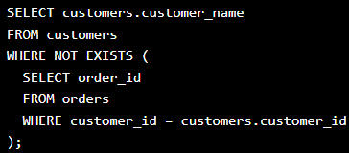
NOT EXISTS
To check which customers that do not have any orders, we can use the NOT operator together with the EXISTS operator.
Example
Return all customers that is NOT represented in the orders table:

Slide 20
Nested Queries in SQL

Slide 21
Subqueries can be used with the SELECT, INSERT, UPDATE, and DELETE statements along with the operators like =, <, >, >=, <=, IN, BETWEEN, etc.
There are a few rules that subqueries must follow −
Subqueries must be enclosed within parentheses.
A subquery can have only one column in the SELECT clause, unless multiple columns are in the main query for the subquery to compare its selected columns.
An ORDER BY command cannot be used in a subquery, although the main query can use an ORDER BY.
The GROUP BY command can be used to perform the same function as the ORDER BY in a subquery.
Subqueries that return more than one row can only be used with multiple value operators such as the IN operator.
The BETWEEN operator cannot be used with a subquery. However, the BETWEEN operator can be used within the subquery.

Slide 22
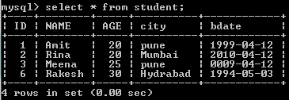
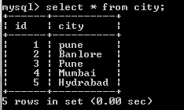
Nested Queries
In nested queries, a query is written inside a query. The result of inner query is used in execution of outer query.
Here we use STUDENT & city tables for understanding nested queries.

Slide 23
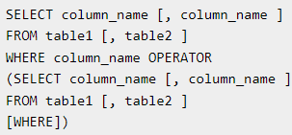
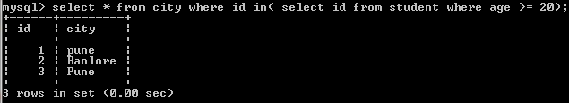

Subqueries with the SELECT Statement

Slide 24
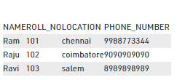


Subqueries with the INSERT Statement
The INSERT statement uses the data returned from the subquery to insert into another table.
The selected data in the subquery can be modified with any of the character, date or number functions.
Syntax:

Slide 25
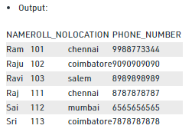
INSERT INTO Student1 SELECT * FROM Student2;

Slide 26



To delete students from Student2 table whose rollno is same as that in Student1 table and having location as ‘Chennai’.

Slide 27
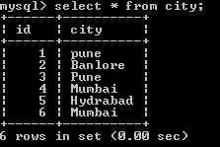
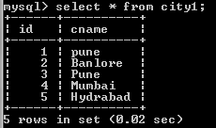

Example 2:

Slide 28
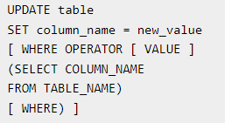
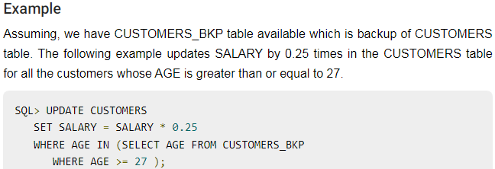
Subqueries with the UPDATE Statement
The subquery can be used in conjunction with the UPDATE statement.
Either single or multiple columns in a table can be updated when using a subquery with the UPDATE statement.
Syntax:

Slide 29
Example
Consider the following employee database.
Employee(emp_name, street,city,date_of_joining)
Works(emp_name,company_name,salary)
Company(company_name,city)
Manages(emp_name,manager_name)
Write SQL queries for following:
Modify the database so that ‘Deepa’lives in ‘Pune’;
Give all employees of ‘Aarya corporation’ a 10% rise in salary.
Display all employees who joined in the month of ‘March’;
Find all employees who earn more than average salary of all employees of their company.

